Slide 1
“Game of Life”
Andrew & Grehg

Slide 2
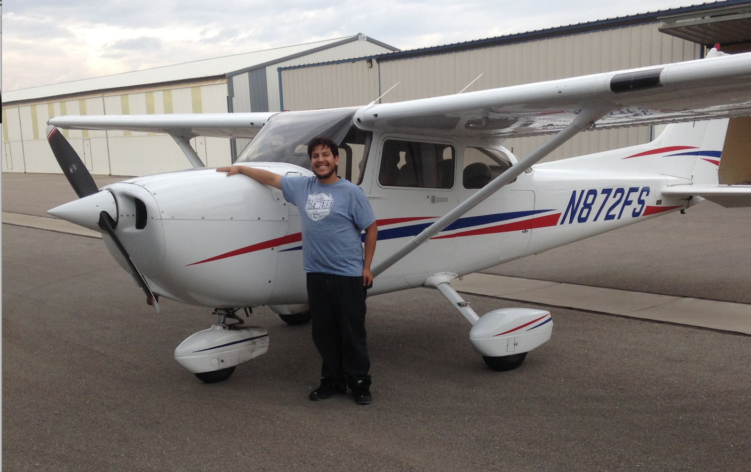
Andrew Koprowski

Slide 3

Grehg Hilston

Slide 4



Slide 5
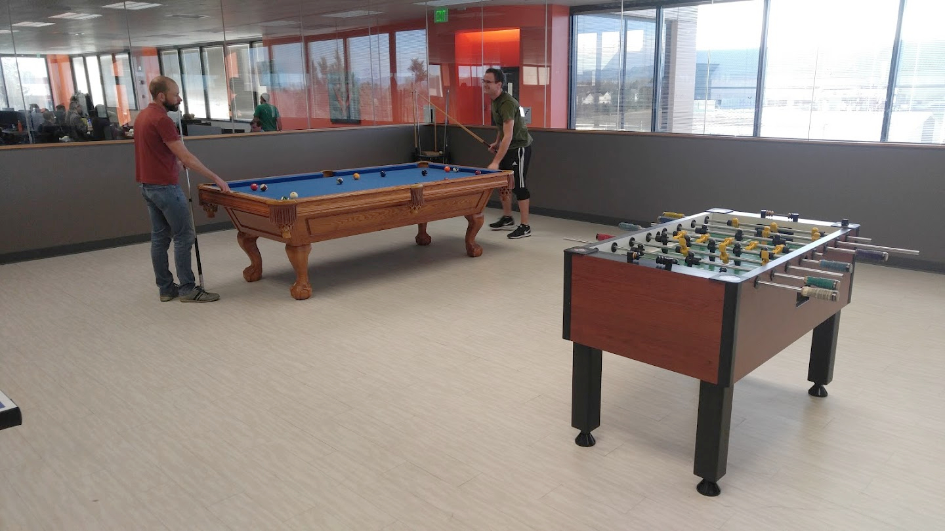

Slide 6
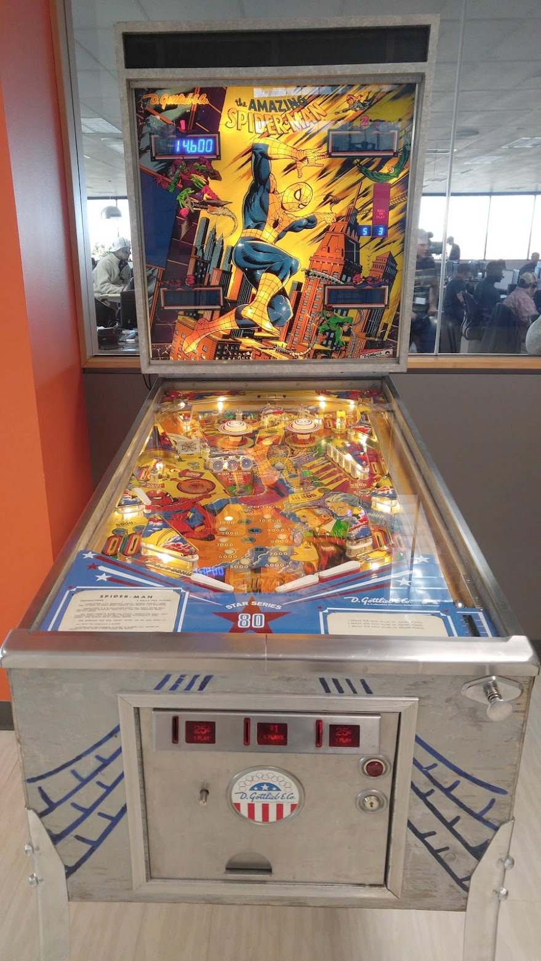
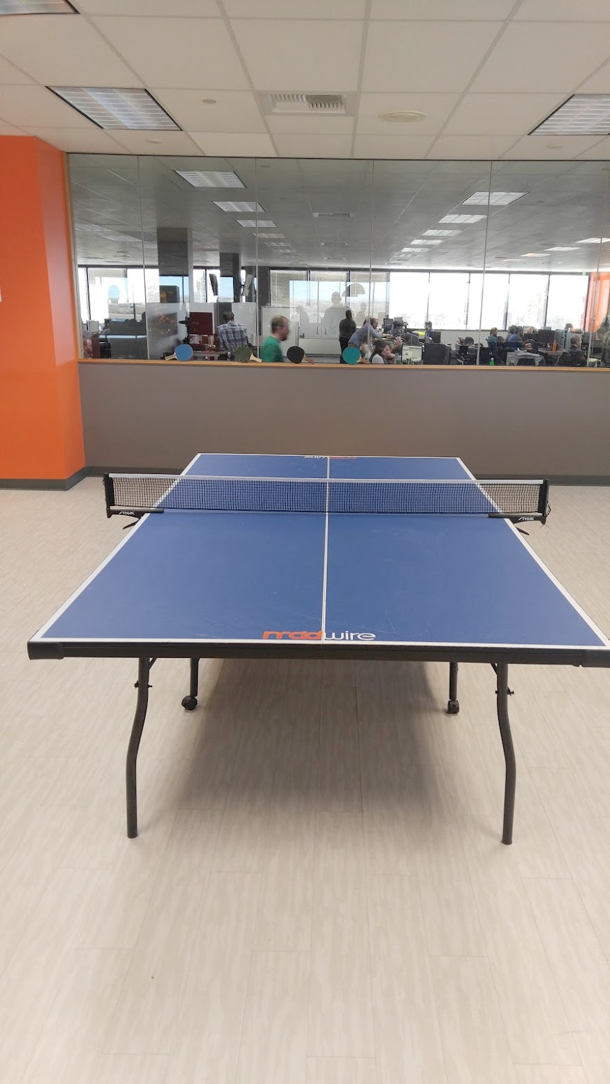
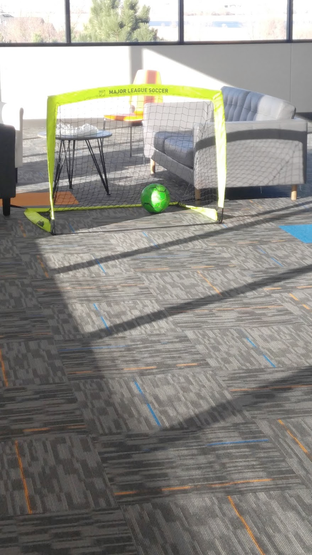

Slide 7
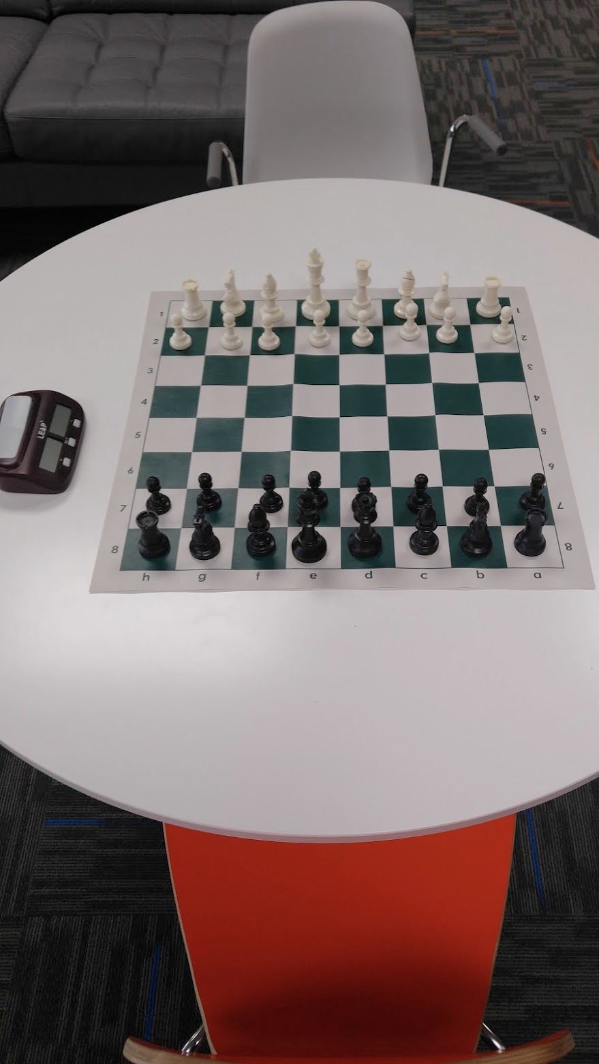
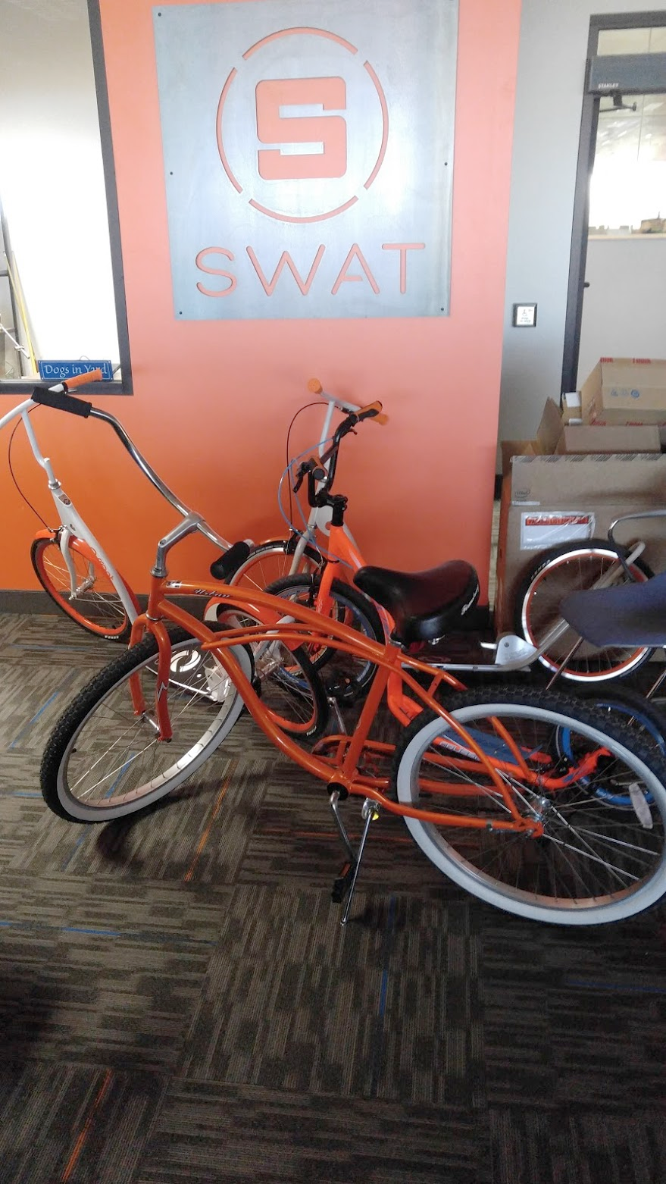
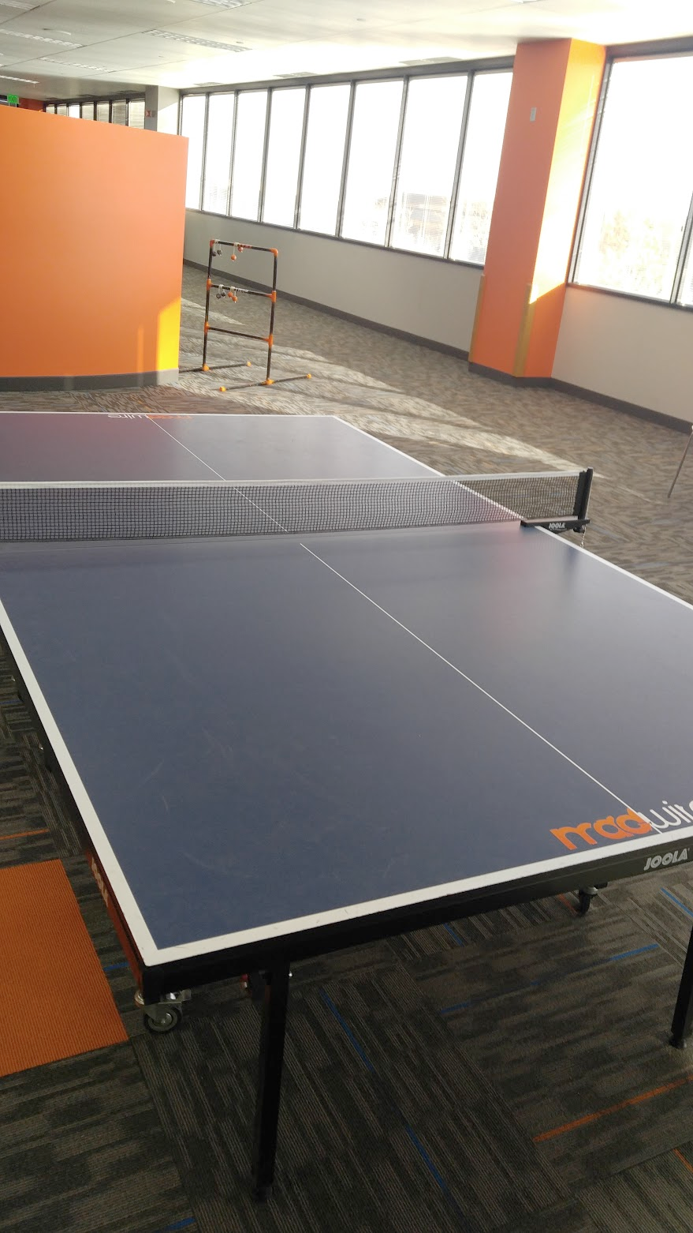

Slide 8


Slide 9

Mobile Team
Notes:
Discussion Questions:
Who has written software before?
What languages have you used or heard of?
Does anyone here plan on studying software engineering or computer science?
How many have Android?
How many have an Apple device?

Slide 10
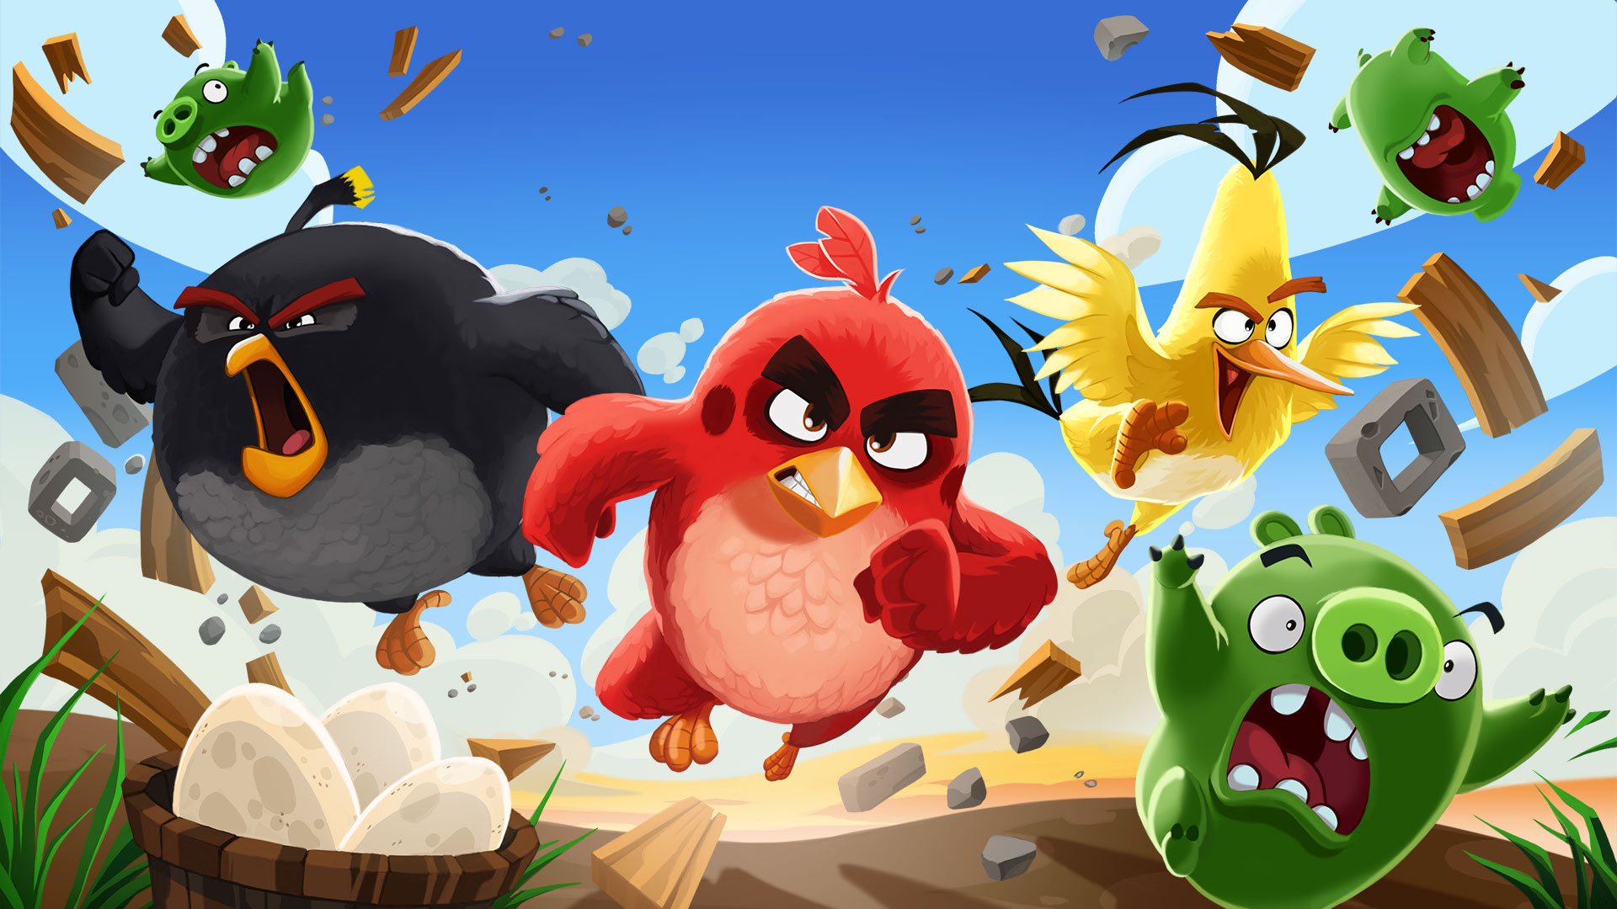
What People thinK I do

Slide 11
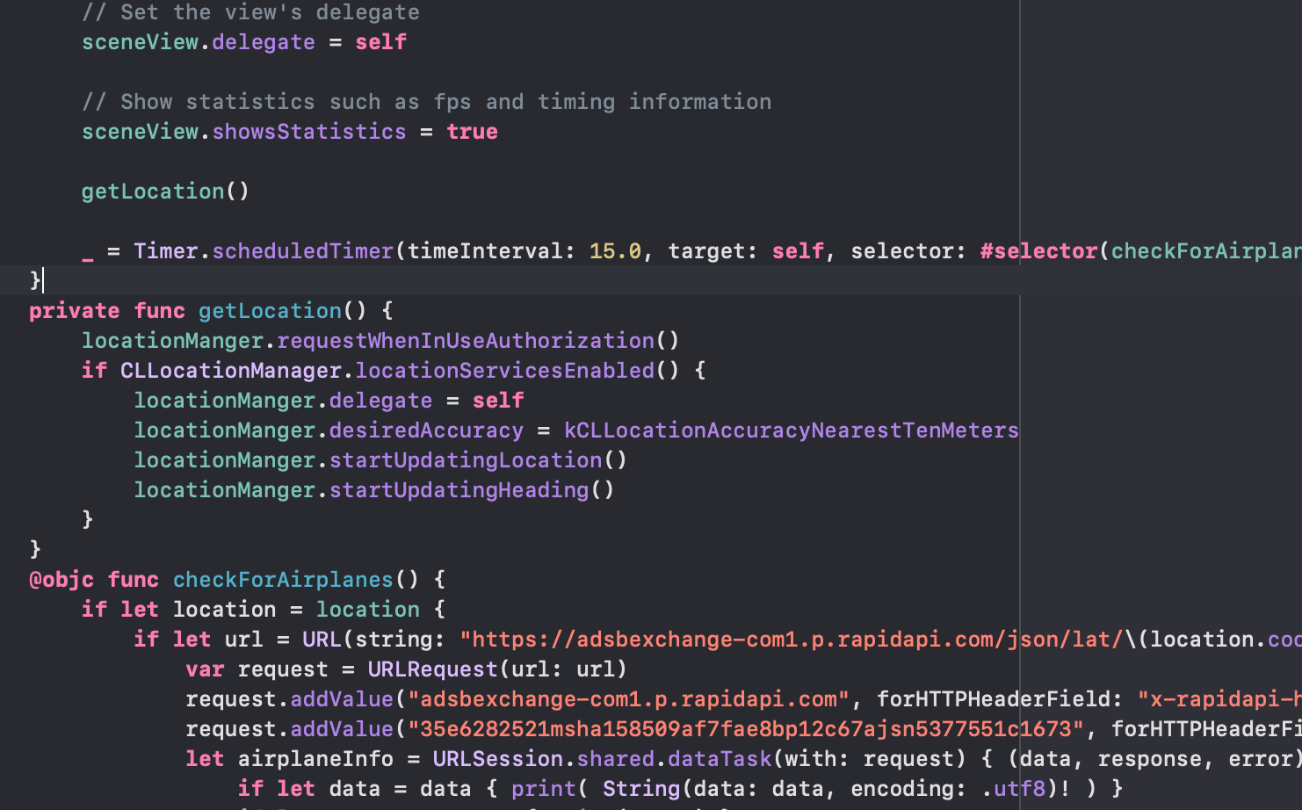
What I actually DO

Slide 12

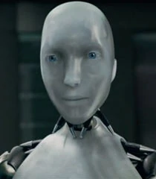



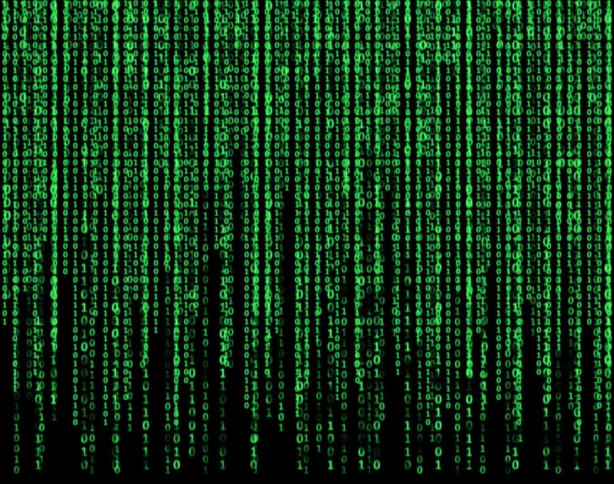
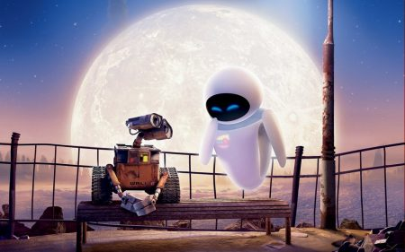
Data Science - What Everyone Thinks I do

Slide 13
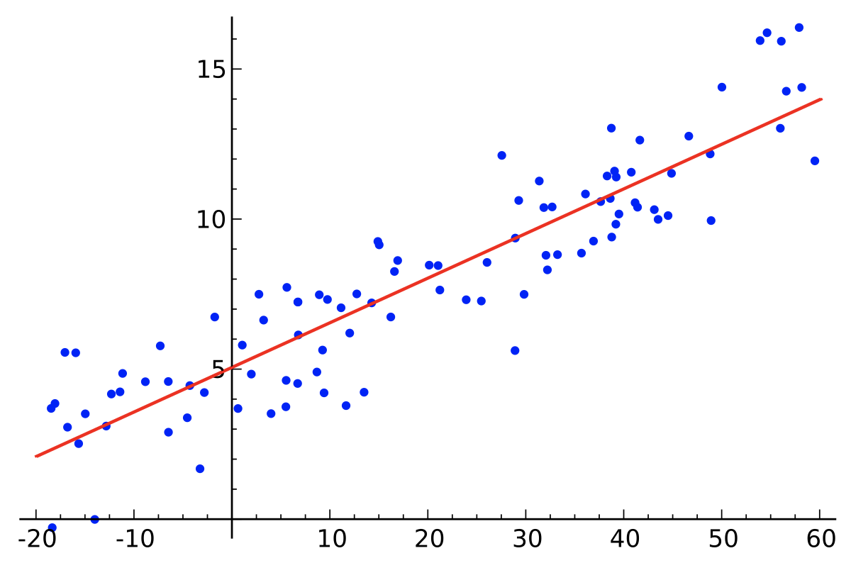
Data Science - What I really Do

Slide 14
Game of Life
goo.gl/eZhkwp
Break off into groups, spend ten minutes playing with the games and try to answer the following questions:
What does this represent?
How does it work?
What patterns did you notice?
If you find something cool, click “Export” and “Link” and save the link so we can explore it.

Slide 15
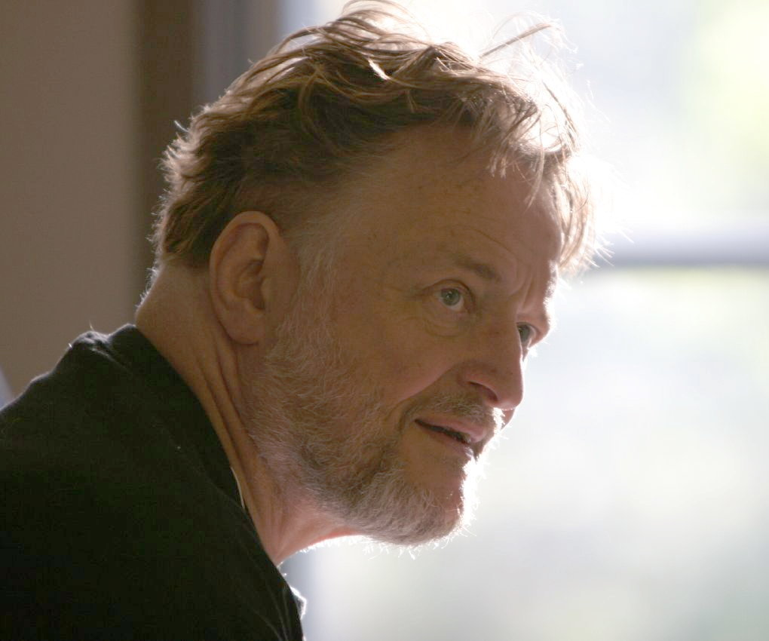
Game of Life
a cellular automata
Created by John Conway in 1970, a British mathematician
Turing complete

Slide 16
Rules
Rules:
  Underpopulation:
    Any live cell with fewer than two live neighbours dies
  Survival:
    Any live cell with two or three live neighbours lives
  Overpopulation:
    Any live cell with more than three live neighbours dies
  Reproduction:
    Any dead cell with exactly three live neighbours becomes a live cell

Slide 17
Live Demo
Lets implement:
Number of live neighbors
Underpopulation rule
Survival rule
Reproduction rule
Overpopulation rule
Notes:
We’ll do this in my Playground’s code and then Kprow’s

Slide 18

Still Life - Block
Example

Slide 19

Still Life - Beehive
Example

Slide 20

Still Life - Loaf
Example

Slide 21

Still Life - Boat
Example

Slide 22

Still Life - Tub
Example

Slide 23

Oscillators - Blinker (period 2)
Example

Slide 24

Oscillators - Toad (period 2)
Example

Slide 25

Oscillators - Beacon (period 2)
Example

Slide 26
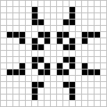
Oscillators - Pulsar (period 3)
Example

Slide 27

Oscillators - Pentadecathlon (period 15)
Example

Slide 28

Spaceships - Glider
Example

Slide 29

Spaceships - Lightweight Spaceship
Example

Slide 30

Spaceships - New Spaceship
Example

Slide 31
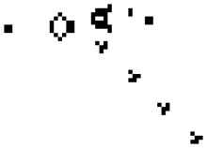
Cool Scene - Glider Gun
Example

Slide 32
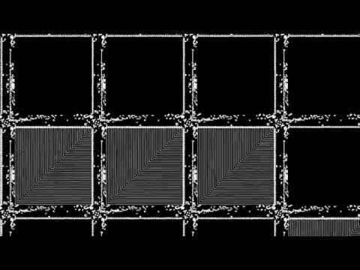
Life in Life

Slide 33
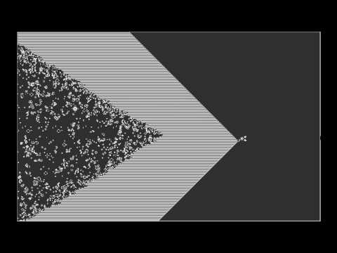
Epic Conway’s Game of Life
Notes:
Start at 1:10

Slide 34
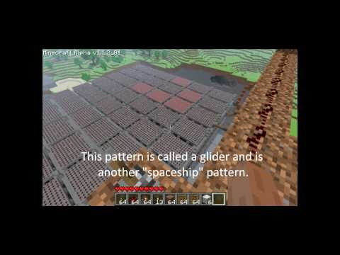
Game of Life In Minecraft
Notes:
Start at 1:10

Slide 35
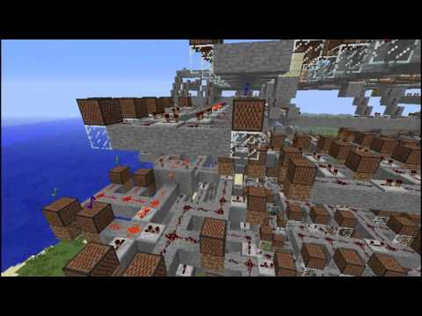
160 Beats Per Minecraft

Slide 36
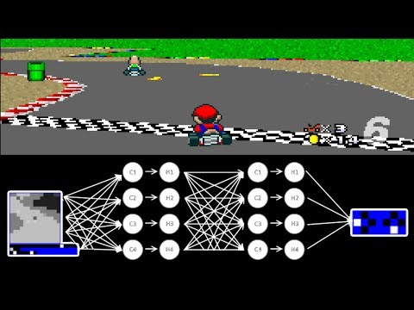
MariFlow - Self-Driving Mario Kart

Slide 37
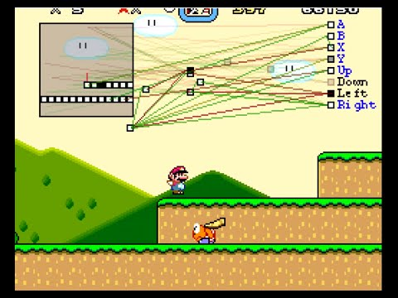
MarI/O - Machine Learning for Video Games

Slide 38
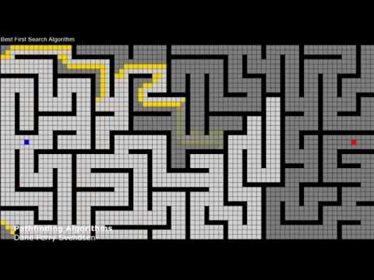
Pathfinding Algorithms

Slide 39
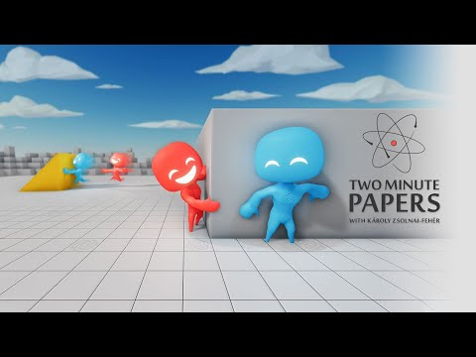
AI Plays Hide and Seek

Slide 40
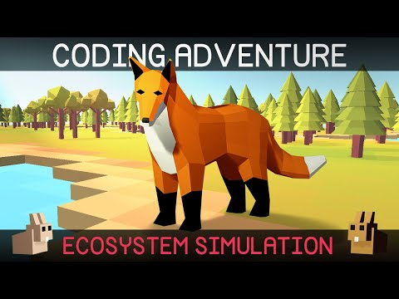
Simulating an Ecosystem

Slide 41
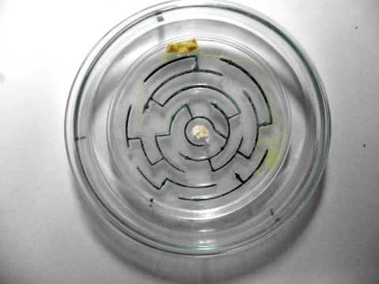
Slime Mold Pathfinding

Slide 42
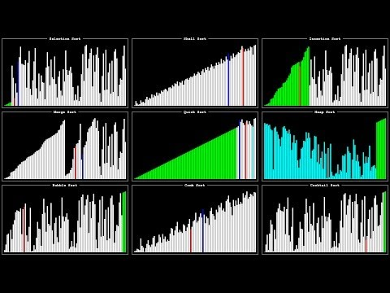
Sorting Algorithms

Slide 43
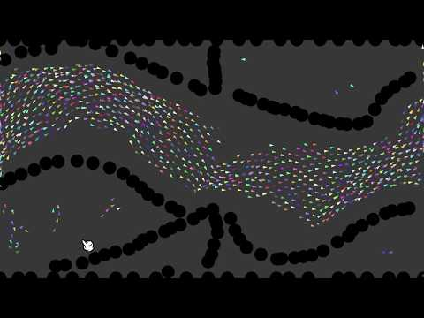
Boids

Slide 44
Programming Usages
Video game development
Virtual reality
Augmented reality
Home automation
Minecraft redstone
Pretty much every industry uses software
  Computer graphics and animation
  Avionics
  Internet connected devices (internet of things)

